Slide 1
Code Course: Lesson 1: ‘The Basics’
Chris Wing

Slide 2
Aims of the course
Initially you will learn the basics of programming in Python, covering operators, statements, variables and basic functions.
We will then move onto further topics such as functions, importing, file i/o, parallelism and concurrency and more.
By the end of the course you should be able to program with Python proficiently on your own.

Slide 3
Course structure
This course will comprise of one 1 hour class each week, along with optional homework set.
The beginning of each new class will always contain a recap section, going over the previous lessons content in brief detail.
After each lesson all class material will be uploaded to a GitHub Repo located at:
https://github.com/OracleChrisWing/CodeClub/issues

Slide 4
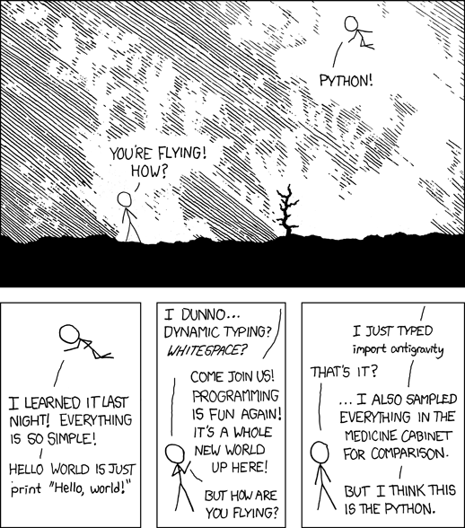
Python?
Notes:
A visual representation explaining how programming is similar to flying. Programming in Python often feels more free compared to other languages such as C.
No type definitions, variable initializations etc.

Slide 5
So what is it?
Designed in 1989 by Guido van Rossum over the Christmas break as a ‘hobby’
Widely used high-level programming language
Supports OOP and structured programming
Utilizes dynamic typing
Designed to be a highly readable language
Notes:
- A high level programming language enables programmers to write programs that are more or less platform independent (specifically concerned with hardware here). Such languages are considered high level because they are more human readable than lower levelled languages (Assembly for example).
- OOP stands for Object Orientated Programming. OOP has the underlying philosophy that everything within a program should be contained within ‘objects’. An object is essentially a collection of code that performs a specific task. Each object is then designed in such a way that is has one specific purpose within the rest of the program. Objects can call upon other objects in order for tasks to be completed.
We wont get into the details now because beginner Python does not require OOP knowledge; however we can touch on it in the future.
Typing; here we are referring to the type of variable that is being declared, not the physical process of typing something on our keyboards.
Dynamically typed languages (such as Python) are languages that do not check to see if the variable in question has been initialized before assigning a new value to it.
Statically typed languages on the other hand are languages that do require the variable to be initialized before having a value assigned to it. For example C, C++, Java.

Slide 6
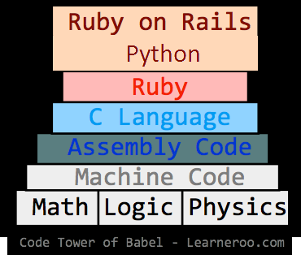
Language abstraction layers
Notes:
This diagram highlights the abstraction layers of some of the popular programming languages in use. Here the lowest levelled language can be considered machine code; i.e. binary. Although no one programs in this directly so the actual lowest levelled language is considered Assembly.
The higher up the scale we go, the more human readable/ friendly the syntax of the respective languages become.

Slide 7
Syntax and semantics
Python uses whitespace indentation to delimit blocks. What does this mean?
Statements and loops (the main ones)
if
for
while
try/catch
Notes:
- In most traditional languages, curly brackets are used to define the bounds of loops. Python however uses whitespace (empty blocks of space).
The IF statement is used to work out decision based logic. For example, A = 10; IF A == 10, SET B = 5;
The FOR loop is used to make iterative loops through lists and arrays. The programmer specifies the number of times the loop should execute and then uses the local variable defined within the loop to loop through the lists.
The WHILE loop is a persistent loop used to constantly execute a section of code while condition X is being met.
The TRY/CATCH block is used when a section of code may or may not return exceptions. For example when reading files through an I/O stream, the program will TRY to read a file, and provided that there are no errors with the specified file the program will continue; if however the file specified is already open in another thread or corrupt, an error will be returned to the program. Without a TRY/CATCH block, the program will now be stuck in limbo, forcing the user to restart it and try again. With the TRY/CATCH block however the program will CATCH the error, parse it to understand what went wrong, and then either output an error message, ignore it and move on, or attempt to re-perform the process that caused the error in the first place.

Slide 8
Built-in functions
Python contains a number of built-in functions that perform various different tasks.
A function is a piece of code that can be called from anywhere within the module (more on this in the future).
A few basic ones:
print
pow
sqrt

Slide 9
Operators
+, -, *, /, **, %
=, ==, !=, <=, >=
and, or, not
“” and ‘’
# and “””
\n and \r
Notes:
(+, -, *, /, **, %) Addition, Subtraction, Multiplication, Divide, Power of, Modulo
(=, ==, !=, <=, >=) Assignment, Equal to, Not equal to, Less than or equal to, Bigger than or equal to
(and, or, not) X AND Y, X OR Y, X AND NOT Y -- [This is all used in Boolean algebra]
(“”, ‘’) These are quote marks used for statements containing strings and characters. Usually strings are contained within double quotes and characters are contained within single quotes.
(# and “””) These are how comments are defined. # is for a single line comment; “”” is for multi-line comment. Comments are a way for programmers to comment their code, to perhaps inform coders picking up where others left off, reminding themselves what a certain functions do etc.
Comments are special because they do not get compiled by the compiler/ interpreter.
(\n, \r) \n specifies to the compiler that the next section of a string being printed to the console should appear on a new line. \r specifies to the compiler that the console wants a carriage return. Think about old type writers and how at the beginning of each new line the writer must return the carriage back to the starting position? This is exactly the same principle here.
What do you think would happen if the programmer only specified \n? Conversely what would happen if they only specified \r?

Slide 10
Hello, World!
x = 10
for a in range(x):
print(“Hello, World!\n\r”)
What do you think the output of this example program would be?

Slide 11
Moving on…
Now we will look at more in-depth functions.
This section will contain functions to capture user input from the command line, format strings and convert between variable types.

Slide 12
Input and format
input()
An example of input:
Number = input(“Please enter a number: ”)
This will print to the console: “Please enter a number: ”
format()
An example of format:
print (“The first number is {0} ”.format(1))
Prints: “The first number is 1”
Notes:
input() – Used to take input from the console/ program by the user and store the value inside a variable.
format() – Used to format strings

Slide 13
Casting
Casting is a method of explicitly changing the type of a variable within the program.
In python, the programmer can cast a variable type to any of the following:
(The basics)
int
float
Str
Bool
To cast, simply type: int(value)

Slide 14
Walkthrough part 1
Lets take a look at an example program :
Takes two different user inputs from the console
Casts them both to ints
Adds the values into a new value
Prints this new number out back to the user.

Slide 15
Walkthrough part 2
This example program will take in a number from the user via the command line, then using that number print out only the even digit values from 0 to MAX_RANGE, where MAX_RANGE is the user defined number.
Breakdown:
Take in a number from the command line
Convert that value into an integer value
Use the ‘for’ loop to produce X number of loops
Check the value of ‘i’ (the loop variable) to see if its even or odd
If even, print ‘i’ to console.
What would we change to make only ODD values print?

Slide 16
Walkthrough part 3
This example program is similar to the second example, with one difference. Instead of only printing even numbers, or only printing odd numbers; this program will print out odd AND even numbers.
To do this, the program will print even numbers whilst the current number is less than or equal to the first half of the range, and then print odd number for the second half of the range.
So for example with a range of 100, between 0 and 50 only even numbers will be printed, then between 51 and 100 odd numbers will be printed.

